Slide 1
Introduction Collaboration and Goals

Slide 2
What does it mean to be a Developer?
A software developer is an individual who plans and creates computer programs based on user needs.
Role:
Software developers are not programmers
Software developers are not designers
Software developers are not business analysts
Software developers are not testers
Software developers are a combination of ALL THE ABOVE AND MORE
Software developers will communicate will clients (directly or indirectly) to identify and create solutions.
Software developers use a variety of tools and technologies to modify, write, debug, document and test software applications, which may invariably change over time.

Slide 3
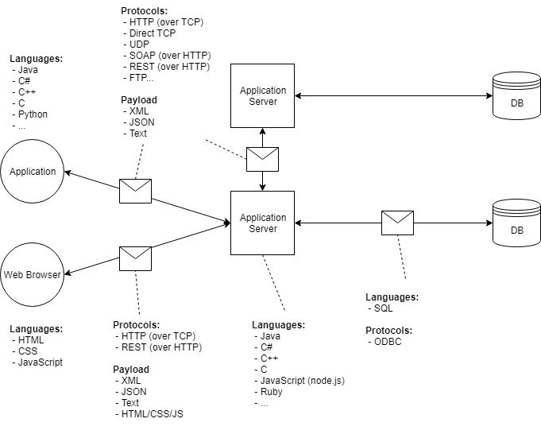
Client-Server-Database Architecture

Slide 4
Broad Categories of Languages
Binary
“0’s and 1’s”, lowest level language, not actually written
Assembly
Language used by the processor (CPU) to generate binary.
Compiled Languages
Written in plain text, so need to be transformed into another form that can be directly used by the CPU (Assembly) or another application (interpreted language)
Interpreted / Scripting Languages
Treated as a series of instructions by other software which in turn generates Assembly from it.
Interpreted languages are generally not human-readable, scripting languages are.
Markup Languages
Used by another application to give context to or describe static content. Not “programming” languages

Slide 5
Decimal Number System
Thousands | Hundreds | Tens | Ones
10³ | 10² | 10¹ | 10⁰
¹⁰⁰⁰ | ¹⁰⁰ | ¹⁰ | ¹

Slide 6
Binary Number System
2⁷ | 2⁶ | 2⁵ | 2⁴ | 2³ | 2² | 2¹ | 2⁰
¹²⁸ | ⁶⁴ | ³² | ¹⁶ | ⁸ | ⁴ | ² | ¹

Slide 7
File System
Your file system informs how files are stored, named and accessed.
Typically forms a tree like structure with some root or top level directory and then directories nested within that.
In Unix, your root directory is represented by the / character
The . character represents the current directory. Furthermore, .. represents the parent directory.
Not every user will have access to the entire filesystem and some may actually only be able to view a select section of the file system.

Slide 8
Absolute and Relative Paths
When structure can be represented as a tree, like a file system, you can express the location of something in that structure with a path.
Absolute: path is “measured” from a root or globally fixed point
C:\Programs\Web\helloWorld.html
/Users/Revature/Documents/file.txt
Relative: measured from the location of another file or directory
../styles/stylesheet.css
With a relative path ‘../’ is used to move outside of the current directly (“one level up”).

Slide 9






Absolute and Relative Paths
Folder A
Cat.html
Folder B
Folder C
Dog.html
Pig.html
Frog.html
Notes:
Use this image to talk through the relative path from one file to another. What if Folder A was the root? Then what’s the absolute path to any of the files?

Slide 10
Command Line
To execute commands for your operating system you will use a command line tool.
Command Prompt
PowerShell
Unix shell
Terminal
GitBash < this is the one we will use
Commands will be specific to your command line tool
Usually there’s an equivalent command in each
You begin with your commands executing from a particular position in your file system.

Slide 11
Common BASH Commands
pwd
Print working directory command
Prints the full name of the directory you are currently working in.
ls
list directory
see the contents of a particular directory
cd
change directory
mkdir
make directory

Slide 12
Common BASH Commands (cont…)
clear
the clear command usually prints several blank lines such that all previous commands are no longer on the screen.
echo
the echo command will print a string or the result of a command to the console.
>
The > operator will redirect the output of a command to a file. The file will be created or overwritten if it already exists. ex. ls . > log.txt
>>
The >> operator acts the same way as the > operator but appends output to the file instead of overwriting if it exists.
grep
the grep command prints any lines in a file or files that match a given pattern. By default, grep interprets the pattern as a basic regular expression.
Print all lines in hello.txt that contain the word goodbye: grep goodbye hello.txt

Slide 13
Common BASH Commands (cont…)
cat
the concatenate command prints the contents of a file to the console. cat hello.txt
head
the head command prints the first ten lines of a file to the console. head hello.txt
tail
the tail command prints the last ten lines of a file to the console. tail hello.txt
touch
the touch command allows you to modify the timestamp of a file. This command is usually used to create empty files, as an empty file is created if touch is given a file name that does not exist. touch hello.txt

Slide 14
Common BASH Commands (cont…)
cp
the copy command creates a copy of the specified file at the location specified. If the recursive flag ( -r ) is used, it will operate on directories.
- copy a hello.txt to goodbye.txt: cp hello.txt goodbye.txt
- copy the A directory to the B directory: cp -r A B
mv
the move command will rename or move a file or entire directory with the recursive flag.
rename a hello.txt to goodbye.txt: mv hello.txt goodbye.txt
move hello.txt to the B directory: mv hello.txt B/.
rename the A directory to C: mv -r A C
rm
the remove command will delete a file. If you use the recursive flag, it can delete a directory. The force flag ( -f) will cause the command to delete files without prompting the user if there are warnings. The command rm -rf . is extremely dangerous.
remove hello.txt: rm hello.txt
remove the hello directory: rm -r hello

Slide 15
Getting help with the command line
man (manual) command in unix displays helpful information about the command. Note that Git bash uses the --help flag in lieu of the man command.
unix: man <command>
i.e. man cat
Gitbash: <command> --help
i.e. cat --help
Google is your best friend as a programmer
Be sure and break down your action into granular steps
Search each step

Slide 16
Git
Version control tool
Allows for safer collaboration between teams
Many different hosting tools for git based repositories.
github, gitlab etc.
git is the underlying software that these platforms rely on, but it is not the platform themselves

Slide 17
Basic Add Program to GitHub
Create repository
Clone repository
Copy/create file in local repository
Stage file for commit
Commit
Push

Slide 18
Example
$ git clone url
$ cd newdirectory
…code is written and saved in this folder…
$ git add .
$ git commit –m “description of work completed”
$ git pull origin main
$ git push origin main

Slide 19
Git CLI Commands
git clone – create a copy of a repository on github.com or gitlab.com onto your local machine.
git add – stage files (staging indicates which files you want to keep a record of or remove. i.e. it tracks your current work)
git commit – take a ‘snapshot’ of your staged files, and inform git to use these as a working standard moving forward. You interact with remove git repositories using these commits..
Note that commit must always be accompanied by a message. Using the ‘-m’ flag will allow you to write a message automatically.
git pull – a command used retrieve and merge the most recent commit from a branch on a linked, remote repository
git push – a command used to copy your local commit from a repository to a branch on a linked, remote repository.
git status – a utility command used to compare your local repository, the stages files, and your record of commits, as compared to the linked repository branch.

Slide 20
Branching
MASTER or MAIN
1
3
7
2
5
6
Branch1
4
Branch2

Slide 21
Create branch
$ git checkout –b “Branch1”
Create a new branch called Branch1.
Then switch to that branch.
Now when you add files and commit it will be to this new branch.
Shorthand for
git checkout “Branch1”
git branch “Branch1”

Slide 22
Merge branch
$ git checkout main
$ git merge Branch1
To merge Branch1 into main
Switch from any other branch to main.
Call git merge from main siting the other branch
Possibly resolve merge conflicts

Slide 23

Forking Repositories
Forking a repository creates your own copy of a project.
Created using the fork button on github
Clone this repo as you would any other to create a local copy.
If you want to pull in changes from the original repo- $ git pull url of original
If you made changes that you want the original to add in --- you create a pull request
You request that they pull in your changes to their repo.

